Slide 1
Welcome to our NPQ Information Session
Alison Halford

Slide 2
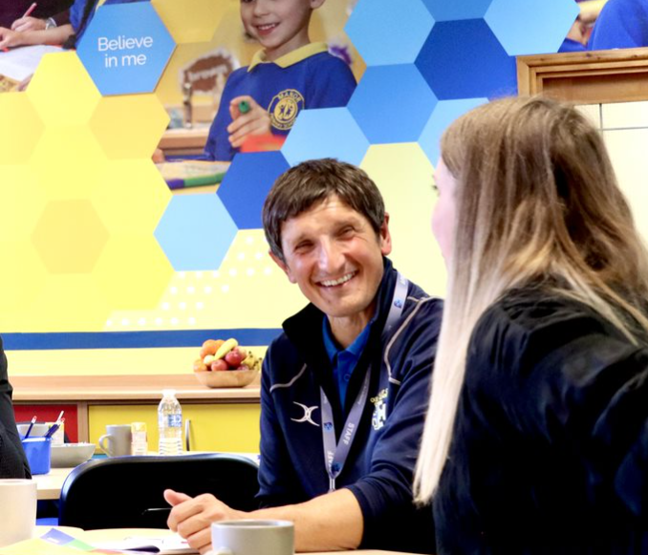
Key Provision
ITE
ECF
AB
NPQs
CPD
Initial Teacher Education – “bringing excellent new teachers into the profession”
Early Career Framework and Appropriate Body services – “the statutory induction services and CPD for new teachers that will help them to be better prepared and supported for their career”
National Professional Qualifications – “providing support for leadership at all levels in school covering specialist areas such as behaviour, teaching, Literacy and Early Years”
Wider CPD opportunities – “linking best practice in the area through the curriculum hubs and peer to peer expertise”.

Slide 3
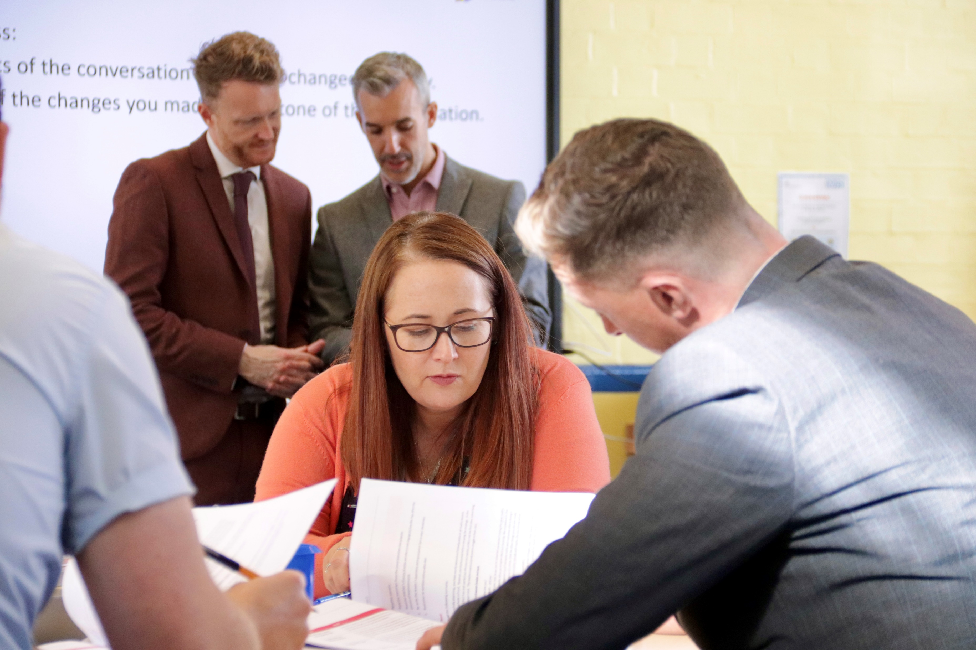
National Professional Qualifications
“Specialist” NPQs
NPQ Leading Teaching
NPQ Leading Teacher Development
NPQ Behaviour & Culture
NPQ Leading Literacy
2 new specialist NPQs due 2024
NPQ Maths
NPQ SEND
And “Leadership” NPQs
NPQ Senior Leader
NPQ Headship
NPQ Early Years Leadership
Recruitment for February 2023 now open and closes 16th January 2024
Frameworks available at https://www.gov.uk/government/publications/ national-professional-qualifications-frameworks-from-september-2021
ITE
ECF
AB
NPQs
CPD

Slide 4
Targeted Support Funding UPDATE Small Schools with under 150 pupils receive a grant of £800*
ALL Primary schools
receive a grant of £200*
Any school with under 600 pupils
receives a grant of £200*
*per npq participant
Notes:
For each teacher or leader a state-funded school and state-funded 16 to 19 organisation employs and who starts a NPQ in the 2023 to 2024 academic year, the following funding grant will apply:
state-funded primary schools with 1 to 150 pupils will receive a grant payment of £800
state-funded primary schools with more than 150 pupils will receive a grant payment of £200
state-funded secondary schools and state-funded 16 to 19 educational settings with 1 to 600 pupils will receive a grant payment of £200
The NPQ participant must also meet the eligibility criteria for the department funded NPQ scholarships.

Slide 6
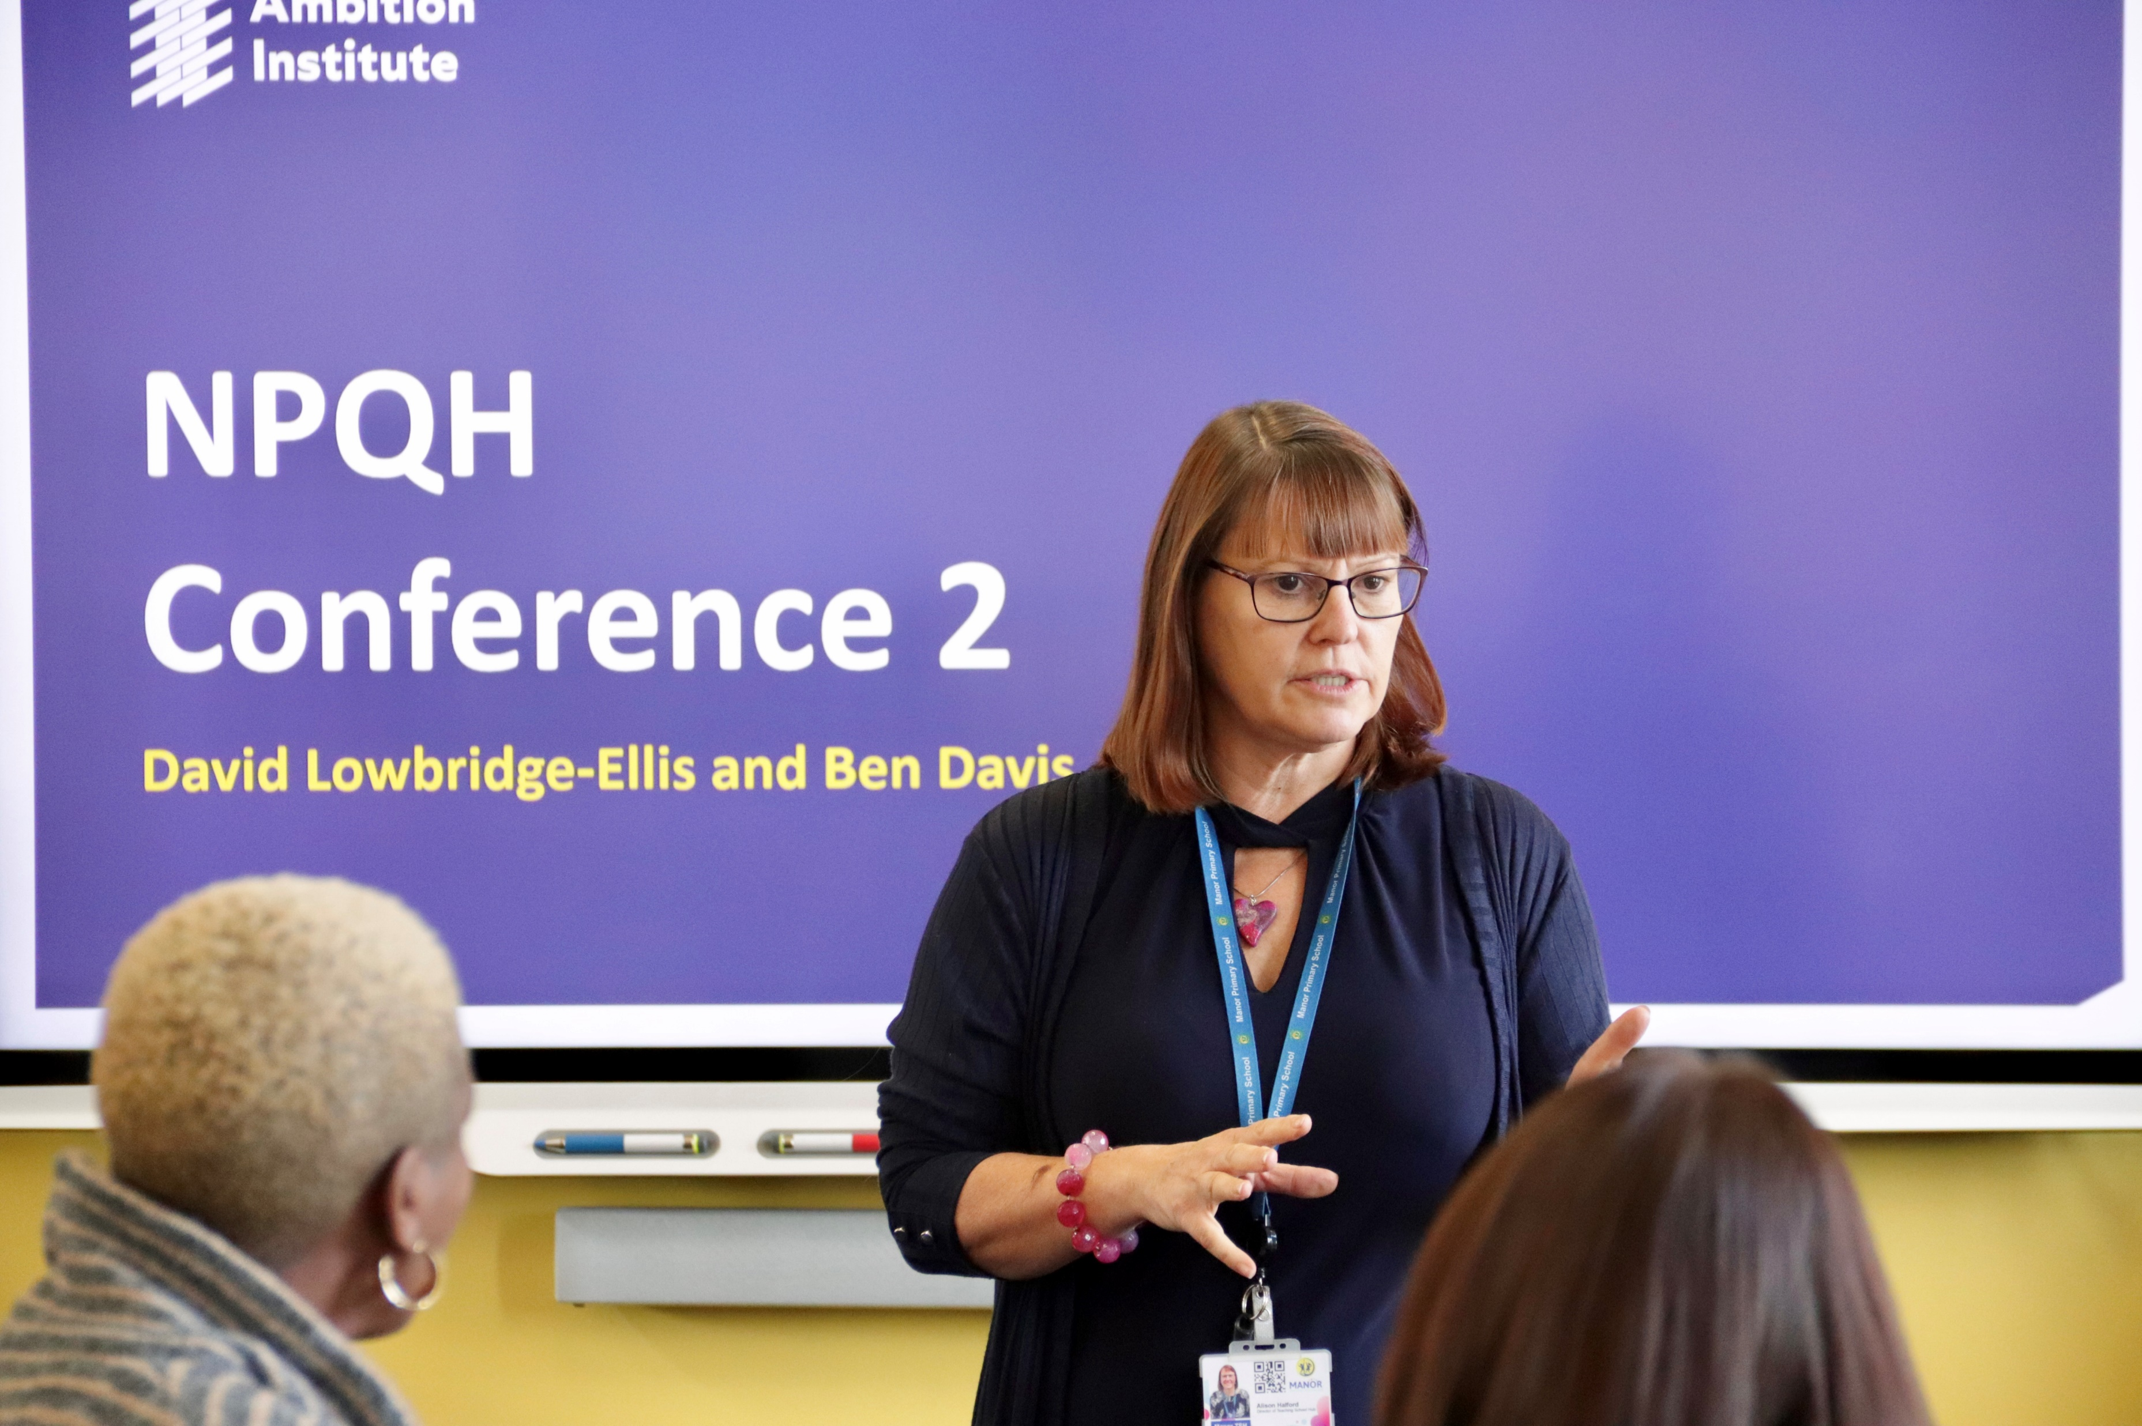
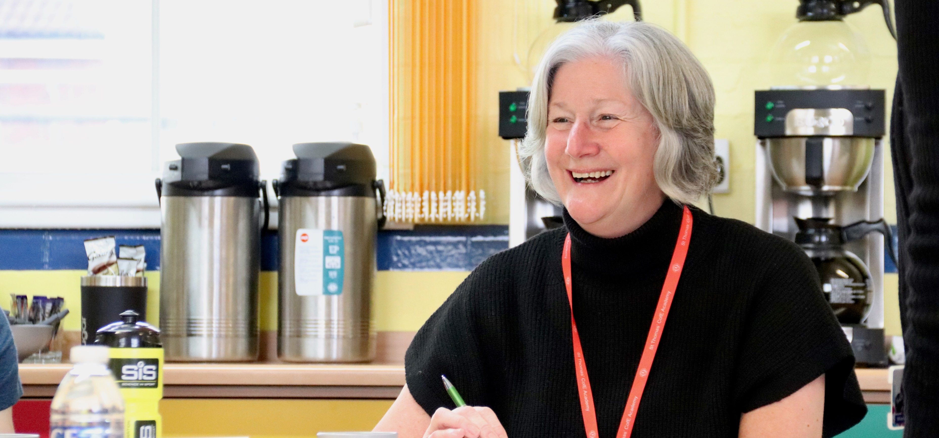
“The NPQ and the Early Headship Coaching Offer really supported me in taking on my first Headship”
The established National Professional Qualification in Headship has been redesigned to ensure you understand all of the core research on teaching and learning and can put that into practice in running a school in any setting. You’ll develop your knowledge and skills to lead school improvement and lead people. This programme aims to develop expertise that is flexible and allows participants to respond to the challenges you will encounter in a range of contexts.
Combines online learning with facilitated sessions and includes a school visit which you organise with a programme buddy.
Delivered once per year – next commencing October 2024.
The EHCO is a year-long programme combining one-to-one coaching with school visits and facilitated leadership development sessions.

Slide 7
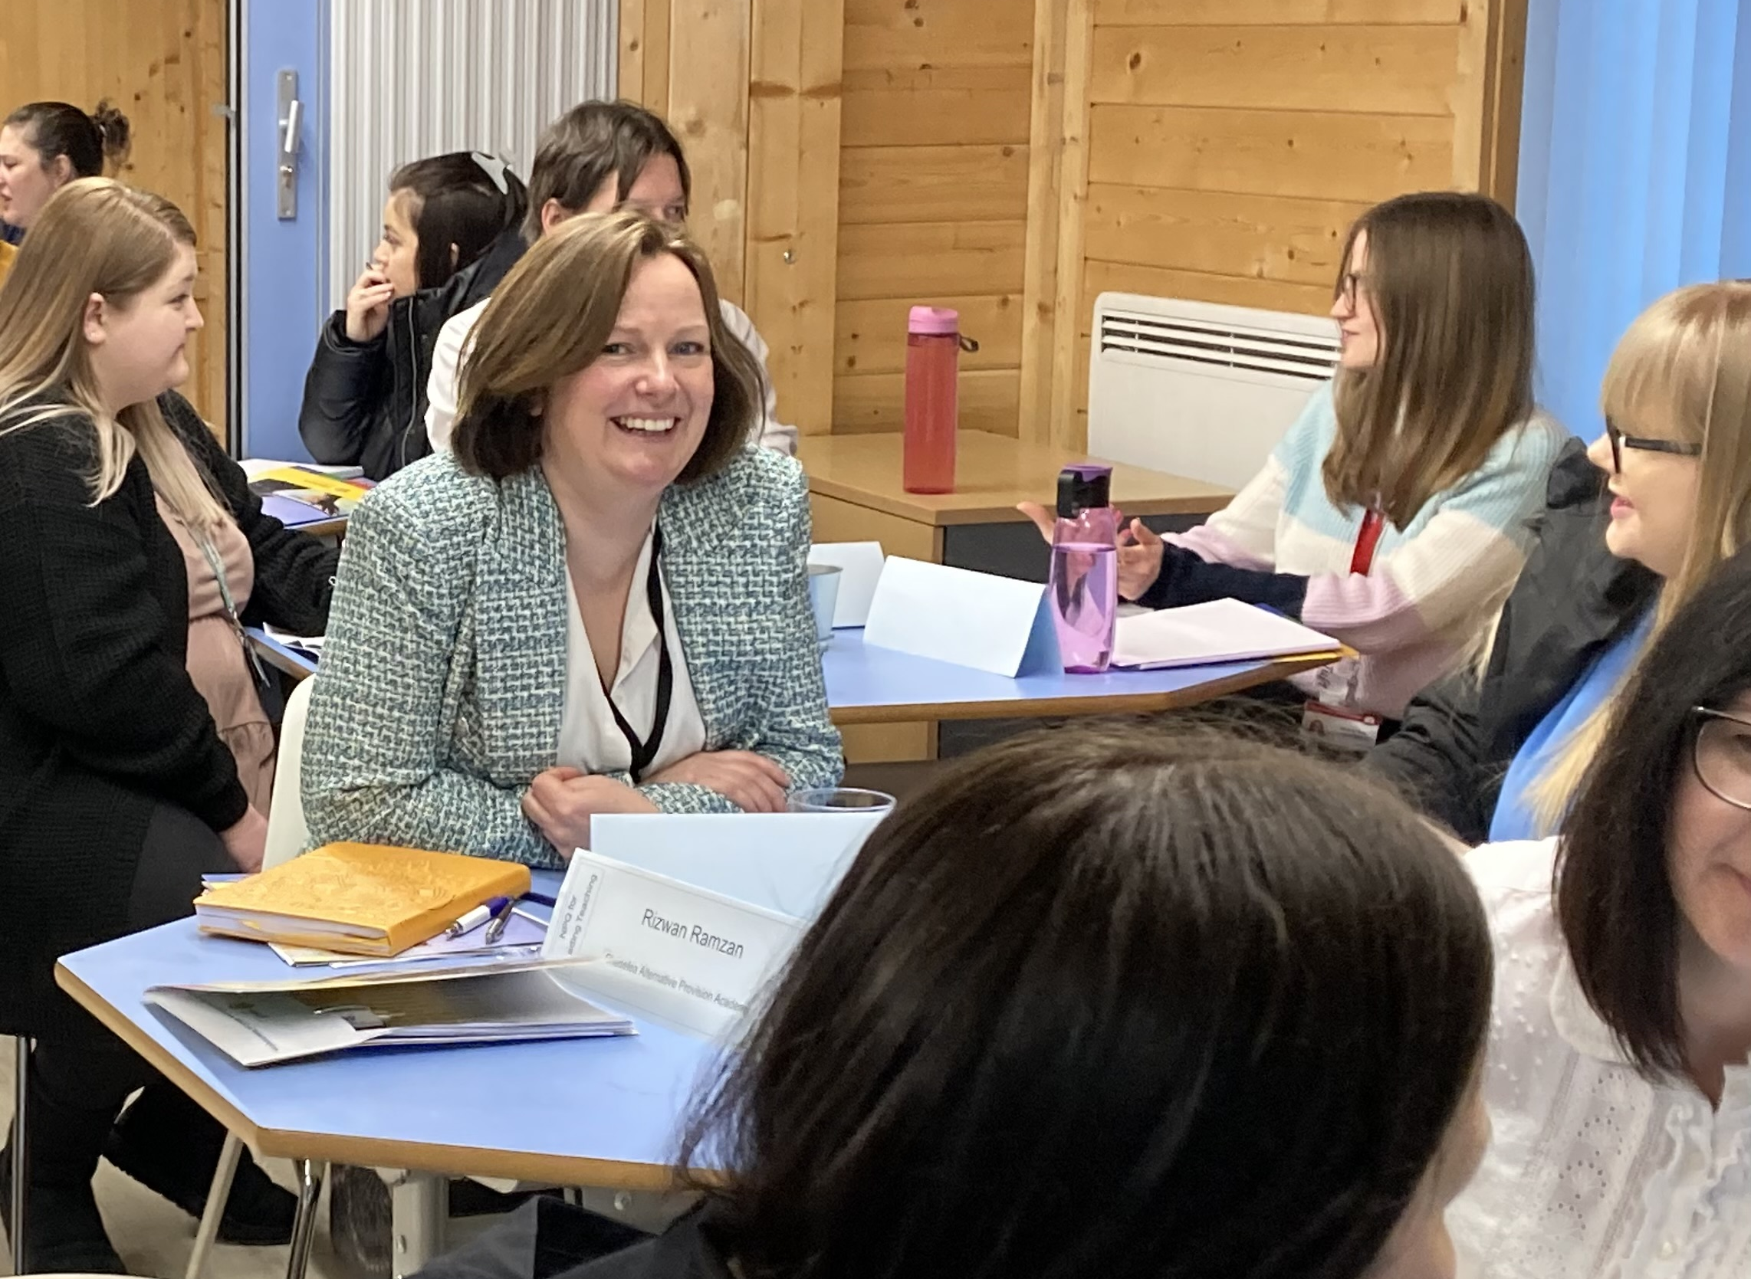
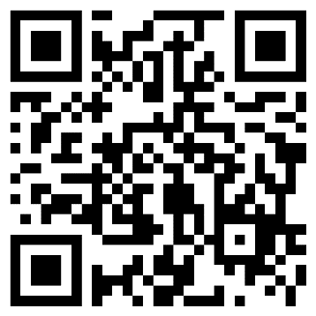
“The top performers in every school should be on this programme”
Every school has top talent that are on the leadership pathway and this programme will give them confidence to step up to the new challenges.
The National Professional Qualification for Senior Leaders is a qualification which will prime your aspirant senior leaders to take on new leadership activities.
Great for retention – we find staff on extended 18-month programmes like to stay in the school that has shown commitment to their CPD. Help talented individuals rise to their potential and support your school for longer.
NPQSL is a fully funded programme. Plus schools with less than 600 pupils receive a £200 grant.
Scheduled to be delivered at Manor Teaching School Hub for February 2024
Now’s the time to commit to your top talent!

Slide 8
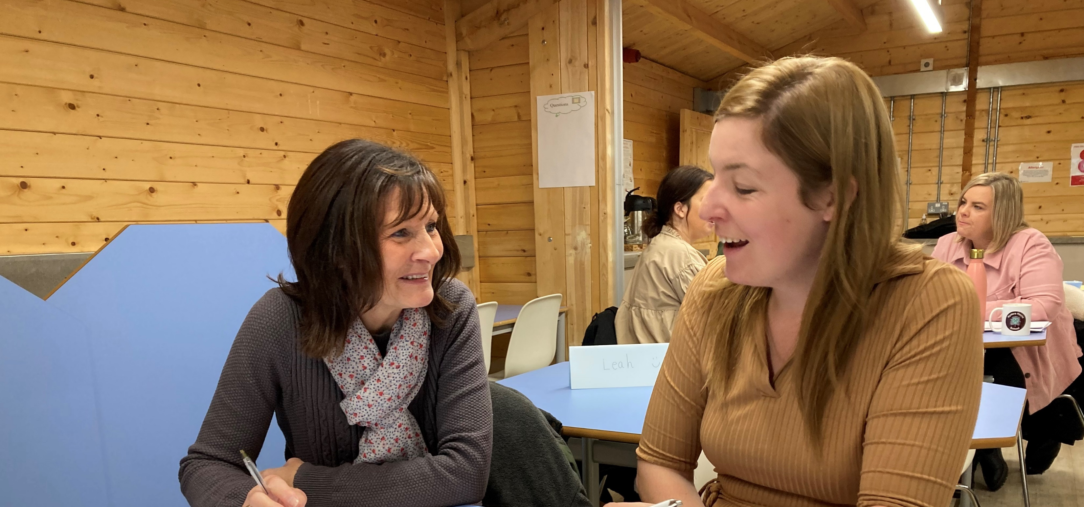
“Every Curriculum lead should consider this”
The National Professional Qualification for Leading Teaching is designed for both Primary and Secondary settings. It will ensure YOUR school has a consistent and thorough understanding of what the best teaching looks like.
NPQLT is a fully funded programme over 12 months for every state school. Take this opportunity to provide excellent CPD for your Curriculum Leaders.
“I’m really enjoying the course and finding that it’s having an impact on my teaching of every subject. I’m able to see the impact with my class too!”
Join colleagues from schools across the area to enhance your knowledge of great teaching.

Slide 9
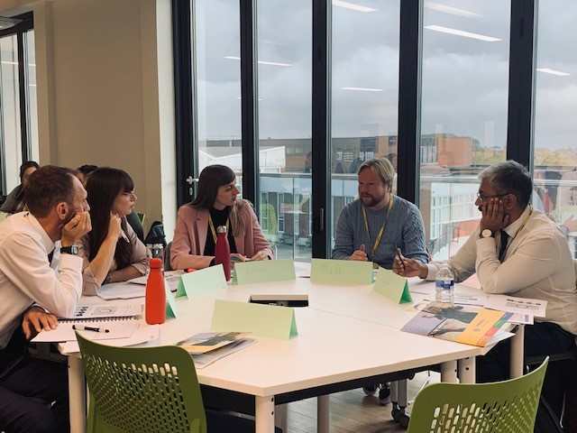
“Powerful learning for Pastoral Leads”
The National Professional Qualification for Leading Behaviour and Culture is a unique national qualification for pastoral leaders (including staff without teaching qualifications). Accessible for leaders from all settings it will ensure your school can incorporate the latest research on creating the enabling conditions for positive learning behaviours.
NPQLBC is a fully funded programme over 12 months for every state school with extra funding for primary schools and smaller schools under 600 pupils.
“Great first conference which was engaging. Plenty of opportunities for discussions facilitated well by the course leaders who were knowledgeable, friendly and insightful”
Due to popular demand, we will now be running a February 2024 cohort.

Slide 10
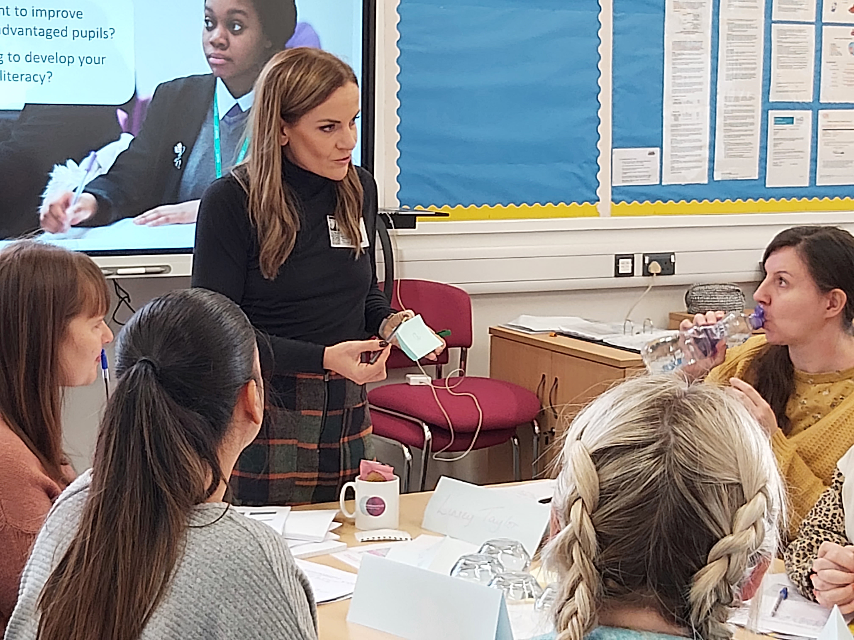
“Literacy underpins access to all other curriculum areas”
The new National Professional Qualification in Leading Literacy is designed for both Primary and Secondary settings. It will ensure your Literacy Lead has full command of the latest research and knowledge to implement effective literacy improvement strategies in your school.
Literacy is the gateway to success in every other subject. Accelerate learning in your school with a focus on literacy!
NPQLL is a fully funded programme over 12 months for every state school. Take this opportunity to provide excellent CPD for your Literacy Lead.
This programme will commence in February 2024

Slide 11
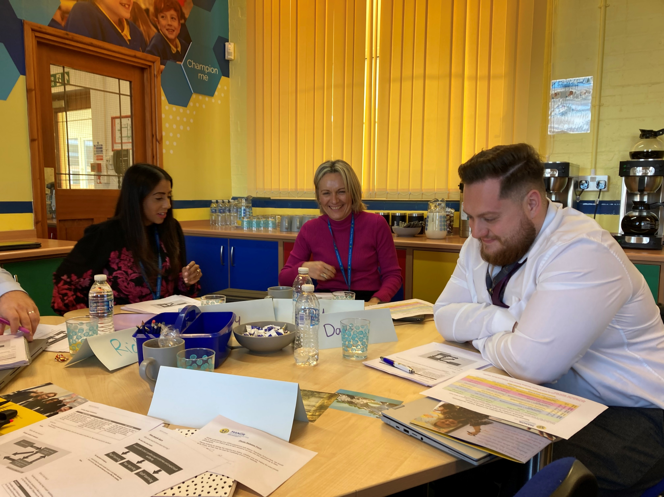
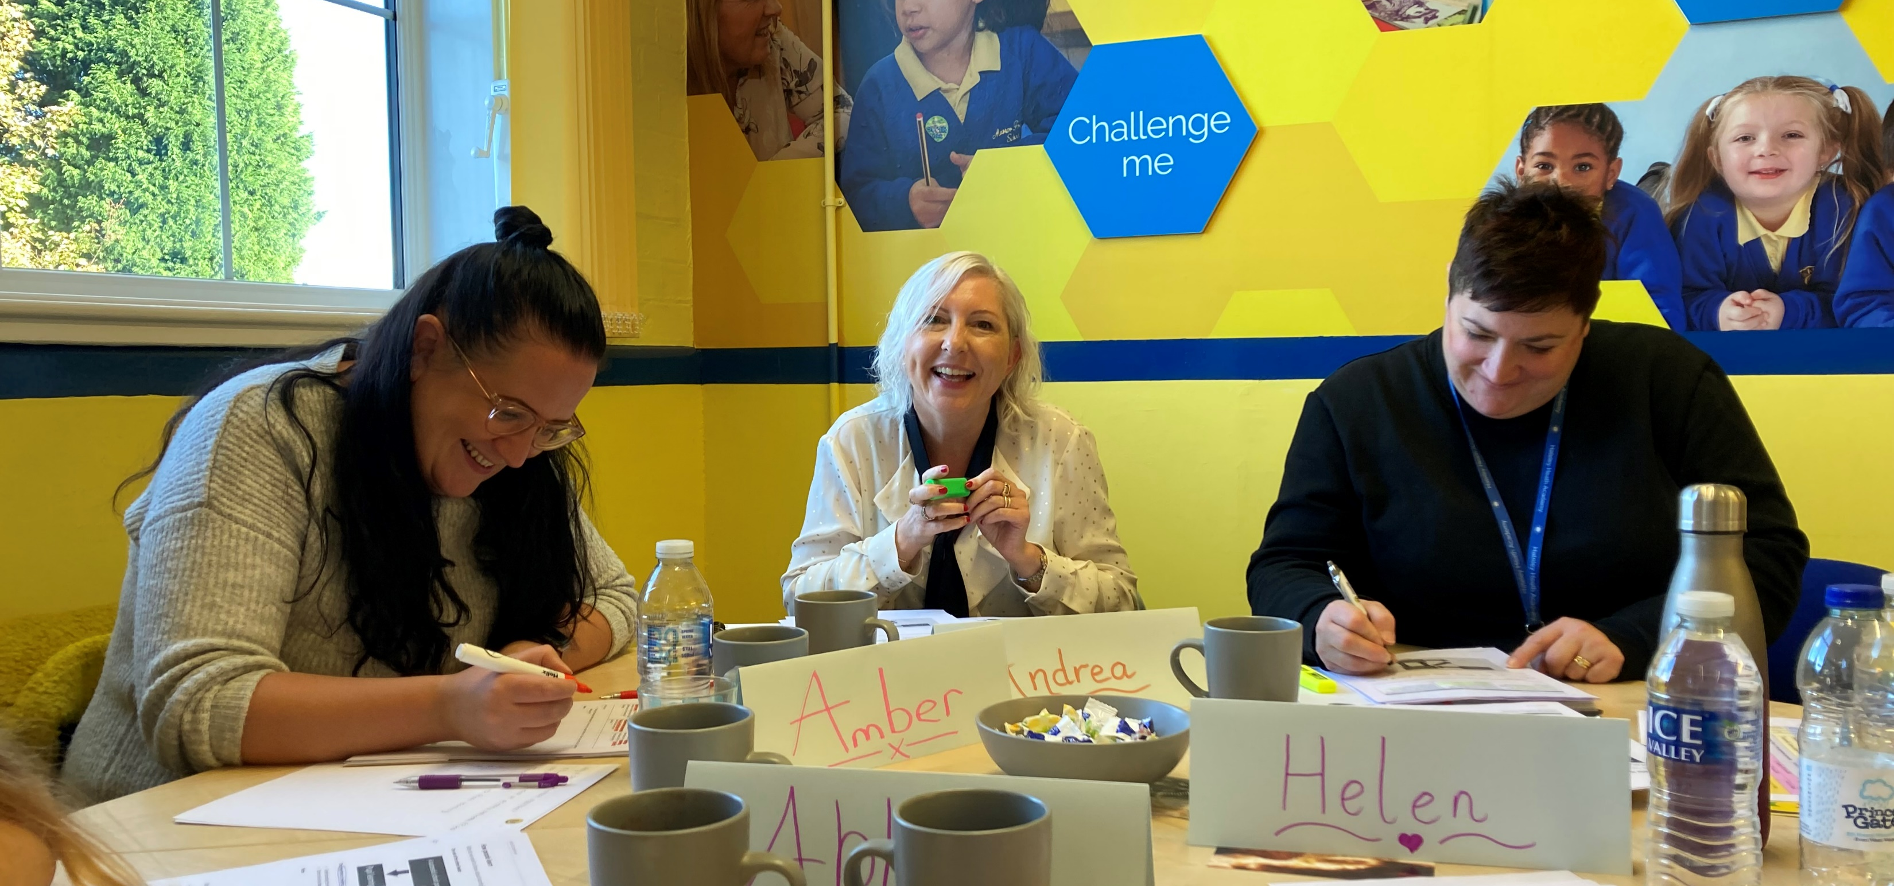
“If you are Leading the development of others in school this is a must have experience”
The National Professional Qualification for Leading Teacher Development provides you with the latest research on excellent teaching plus the latest on constructing excellent CPD so that you are equipped to disseminate this to others in your school.
Whether you are a Lead Mentor or a CPD Lead this will provide you with the confidence to support others in the knowledge that you are completely up to date with the research.
“I encouraged my leaders to complete the course at the same time so that we would have a shared understanding and language for developing teaching and learning across the school”
Headteacher, Foxyards Primary.

Slide 12
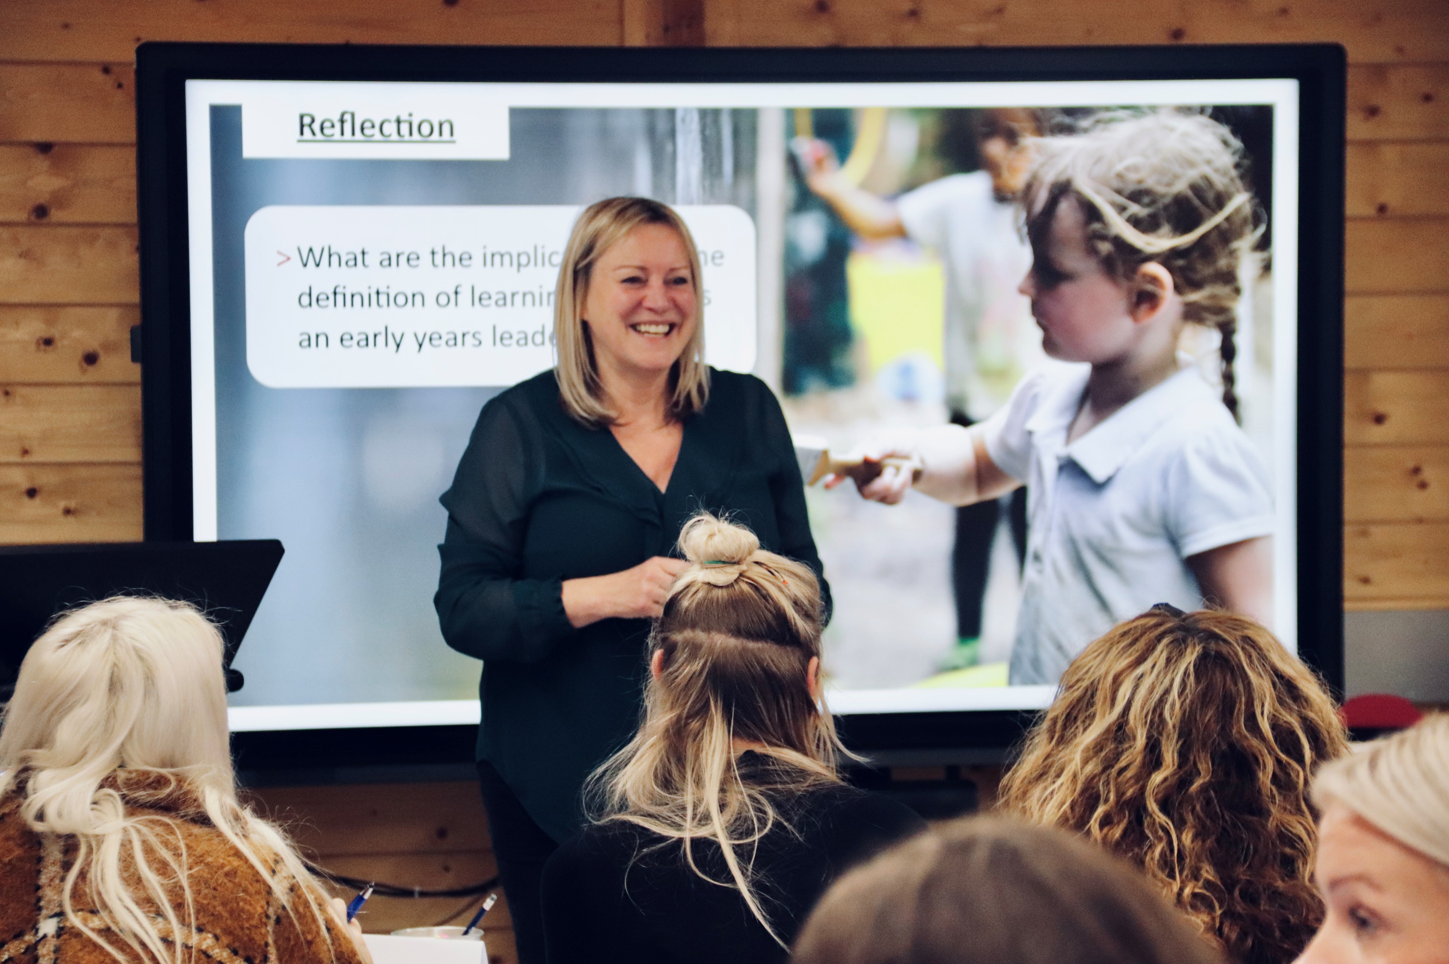
“Finally, a qualification targeted at leaders of Early Years”
The National Professional Qualification for Early Years Leadership is a unique national qualification for settings registered on the Ofsted Early Years Register as one of the following organisations:
a maintained nursery school in England
a pre-school class or nursery that’s part of a maintained school in England
a pre-school class or nursery that’s part of an independent school in England providing free early years entitlements places
a nursery that is registered on the Ofsted Early Years Register
a childminder and registered on the Ofsted Early Years Register, or with a registered Childminder Agency
As a leadership programme, the content is pitched at LEADERS in these settings rather than teachers.

Slide 13
New NPQ for Leading Primary Maths
The new NPQ in Leading Primary Maths was announced in April 2023 and the first cohort is February 2024
The aim of the programme is to develop a school culture with a positive attitude to maths and therefore in the programme you’ll learn:
about how pupils learn, so you can develop systems which help children overcome maths anxiety and develop problem-solving strategies,
how to design maths curriculums and develop leadership skills to help you introduce them,
techniques to help you support maths teachers, including techniques to help them:
plan lessons, for example sequencing lessons so that pupils can build their knowledge
support inclusion of pupils, for example ensuring that the starting point is accessible to all
manage their workload, for example by sharing approaches to marking work
understand and use consistent maths vocabulary.
Eligibility criteria - participants require one year of maths mastery training
We will be partnering with local Maths Hubs in the delivery of this programme

Slide 14
New NPQ in Leading SEND
The new SEND NPQ was announced in the SEND review (March 2023)
It will become the new qualification for SENCOs and will replace the existing NASENCO qualification.
The Framework, which details the expected content for the programme, can be seen on the DFE website.
First cohorts planned Oct 2024
Prior to the commencement of this qualification Manor Teaching School Hub is running SEN leadership CPD with Simon Mosley.

Slide 15
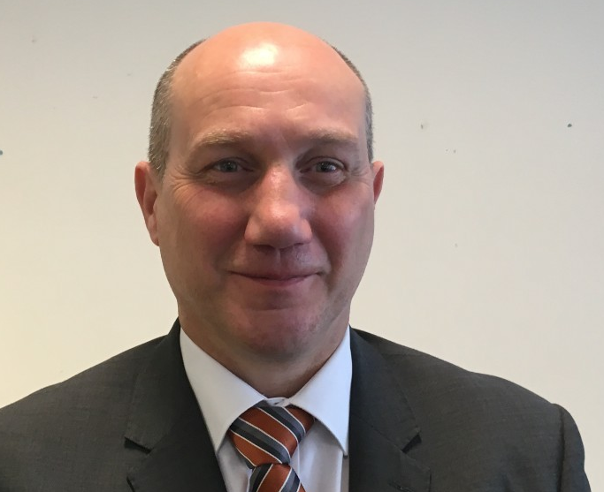
Creating an ambitious environment for SEND pupils
Every school wants to create an environment where pupils with SEND achieve exceptionally well; where a curriculum is ambitious and designed to give all pupils, including pupils with SEND, the knowledge they need to succeed in life. Subject and phase leaders have a key role in supporting every pupil to succeed.
This one-day course (for either primary or secondary) will provide a clear understanding of how to develop ambitious SEND provision which will naturally lead into the NPQ for SEN when this is launched.
Senior Leaders on this programme will consider:
whether their provision is ambitious for pupils with SEND
how they identify, assess, and meet the needs of pupils with SEND
the learning environment for pupils with different needs
how well they adapt the curriculum so that it is coherently sequenced for all pupils
strategies and resources to support colleagues, including early career teachers, within a department to develop their practice
what adaptive teaching looks like in their area
how successfully they involve parents/carers and specialist services in support of pupils with SEND
Delivered by Simon Mosley
Full day 5th December (9.30 - 3.30)
Or
Two mornings 30th Jan & 14th March 24 (9.30 – 12.30)

Slide 16
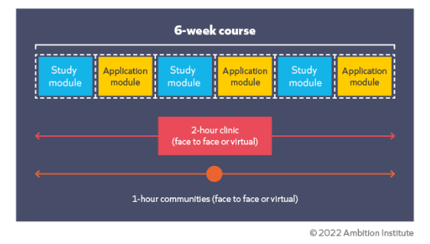
The NPQs - structure
National qualifications underpinned by extensive research
Delivered by highly experienced local leaders as your facilitators
Assessed at the end of the programme
Blended Learning throughout includes :
A full-day face to face Conference at the outset
Twilight Clinics – some virtual and some face-to-face
Online learning you complete in your own time on a fortnightly basis
Buddy discussions about the on-going learning
Leadership programmes last for 18 months
Specialist programmes last for 12 months
ITE
ECF
AB
NPQs
CPD

Slide 17
A great start to NPQs Here’s what people say about facilitators
“Really insightful and refreshing delivery. The day has been full of content, but this has been delivered in an interactive and inspiring way. Practical approach to go through the clinic and community model has been very useful thank you.
“Able to relate to them. Good that one is primary based and Secondary based. ”
“Both facilitators were really engaging, and it was wonderful to hear their real-life stories to help give context to the information presented.”
“I feel reassured and encouraged by the way that they delivered the day. They were supportive and realistic about the course and gave me a lot of valuable advice. I’m really looking forward to getting started now, thank you!”
“Really engaging facilitators. So thought provoking - brilliant CPD, thank you.”

Slide 18
An example of the online module content (from EYL)
Online Module 1 - Implementation
Online Module 2 - Culture
Online Module 3 - Child Development
Online Module 4 - Professional Development
Online Module 5 - Effective Early Education
Online Module 6 - Curriculum and Assessment
Online Module 7 - Additional and Special Educational Needs and Disabilities
Online Module 8 - Organisational Management
Online Module 9 - Working in Partnership

Slide 19
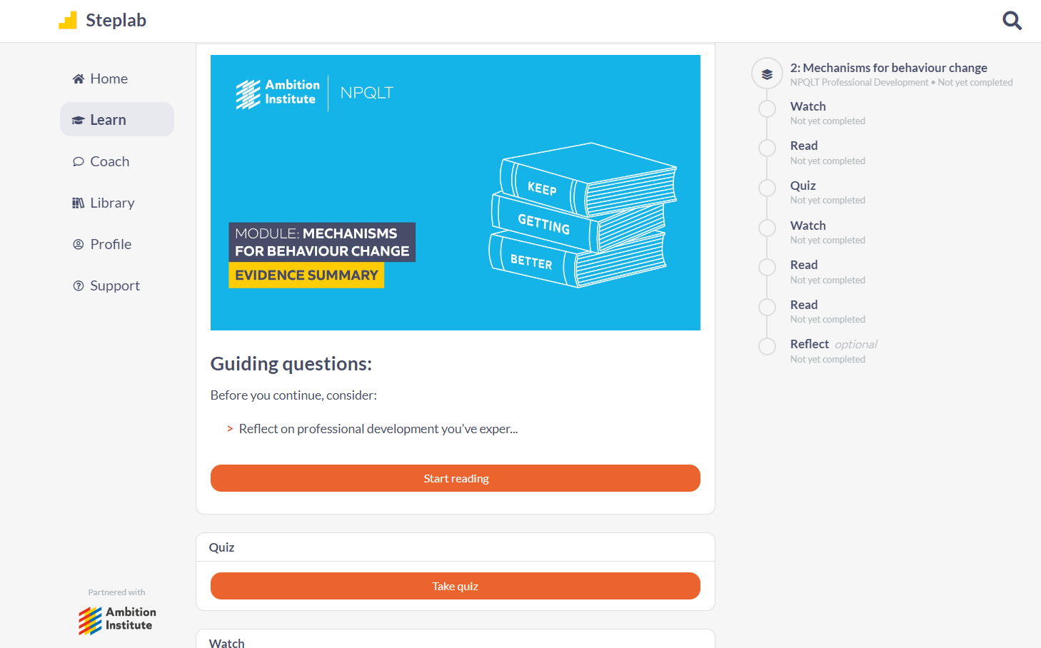
Steplab - an easy to use online learning system

Slide 20
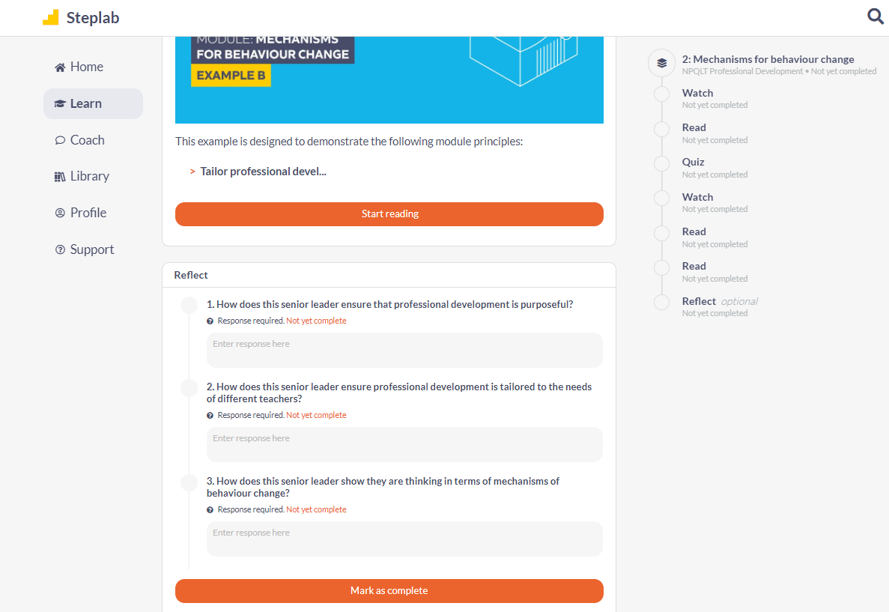

Slide 22
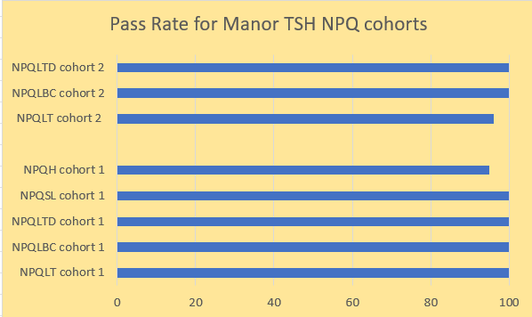
Excellent Pass Rates

Slide 23
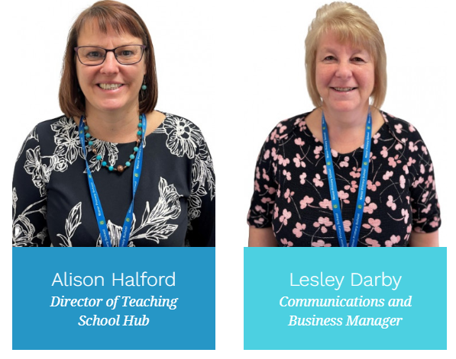
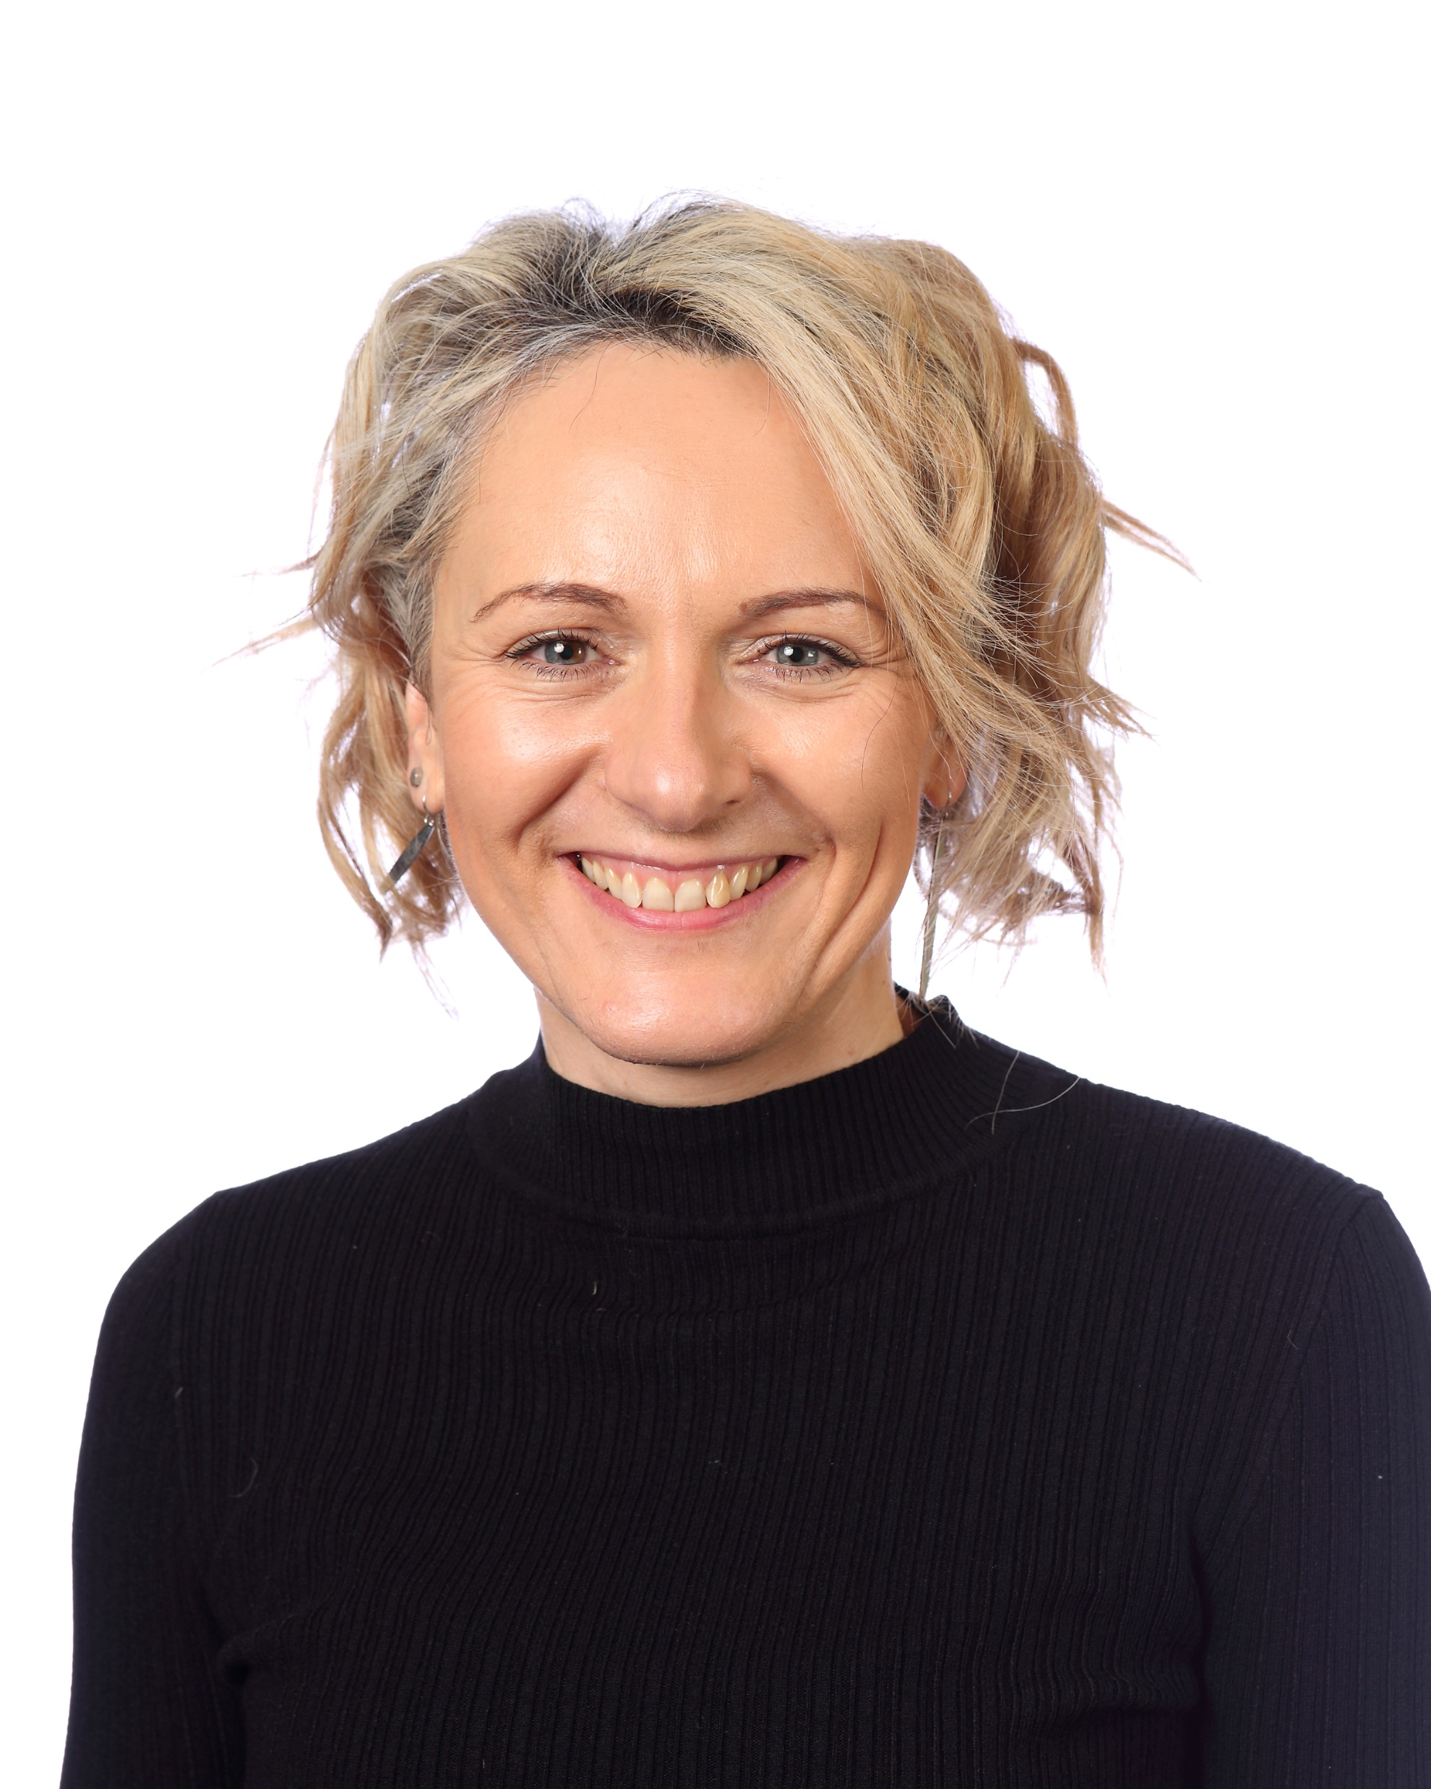
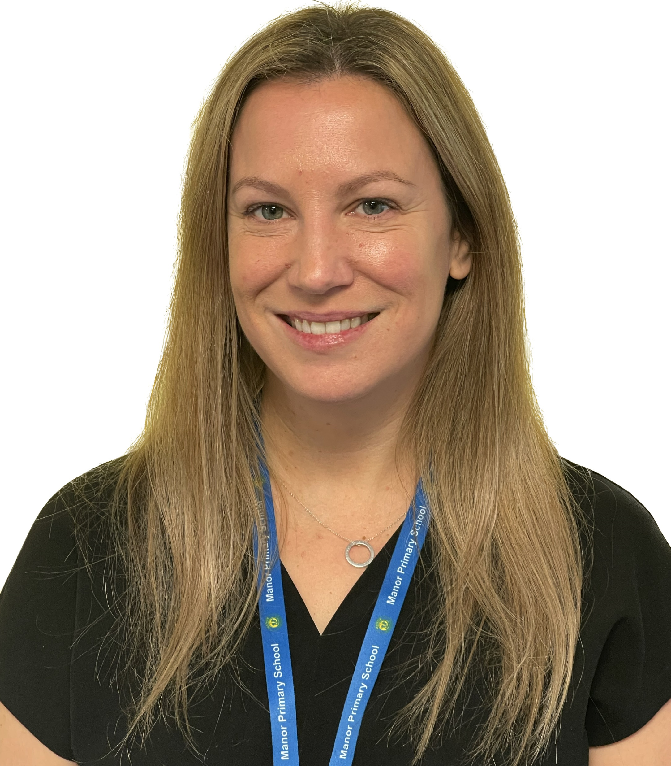
What to do next
Register your interest
or email info@manorteachingschoolhub.com
with delegate names, emails and preferred course.
The team is here to help you.
Lou Wedge
Lead for ITT and AB
Liz Marson
Administrator

Slide 24
Thank you for your time
Any Questions ?
We keep in touch by:
Newsletter
Website
Twitter @ManorTeach
Always there to help at info@manorteachingschoolhub.com

